Slide 1
READ ONLY MEMORY (ROM)
Presented by
Hilal Ahmad khan
Hamza khan
Presented to
Sir Ali Haider

Slide 2
Introduction to ROM
Read only memory rom, is a type of non-volatile memory used to store permanent data.
It is also referred to as secondary memory and is used as a storage medium in devices such as computers, mobile phones, IoT devices, etc. Read only memory is less efficient than primary memory (RAM), but it costs much less in comparision to RAM.
Here are some of the key features of rom
It’s non-volatile, meaning it retains data even when the power is off
ROM typically stores firmware or software that rarely changes
It’s generally slower than RAM but faster than a hard drive
Data in ROM is “read-only” and not easily modified.
What is Read Only Memory.

Slide 3
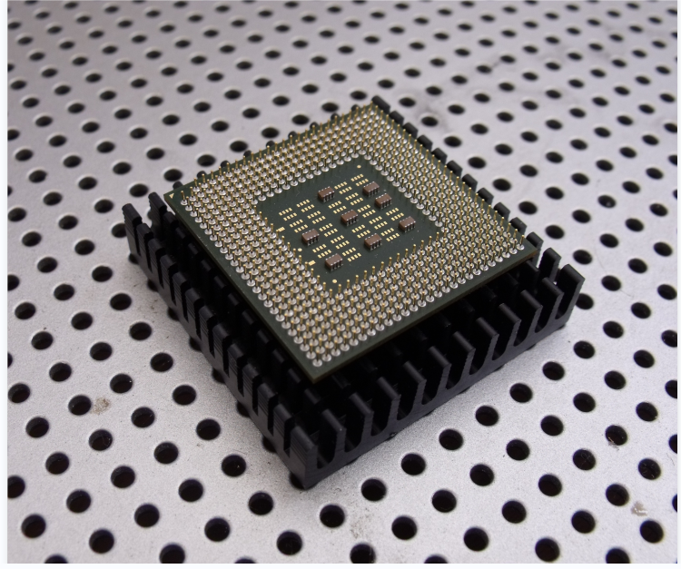

Slide 4
Types of Rom
There are the 5 types of read only memory
A. M.ROM
MROM is an abbreviation for Masked Read Only Memory. It is a read only memory chip that is programmed (data is stored in it) during it's manufacturing. MROMs cost relatively low.
MROMs were the first ROMs to be developed and were hard wired, contain a pre-programmed set of instructions or data. During the design phase in the manufacturing process of a MROM, a software mask is burned directly onto the chip.
B. P.ROM
PROM is an abbreviation for Programmable Read Only Memory. PROMs are also called as PLD(programm logic Device), as they are used in logic designs. It's a device that includes both the OR plane as well as the AND plane within a single IC package. AND plane is fixed and OR plane is programmable. A plane is a sequence of gates such as AND, OR, etc

Slide 5
C. EPROM
EPROM stands for Erasable Programmable Read Only Memory. It is a chip that is non-volatile in nature and was invented in 1971 by Dov Frohman at Intel. An EPROM can be reprogrammed if required by exposing it to ultraviolet light. But otherwise, an EPROM does not save or accept any new data. EPROM chips are not used in modern computers as they have been replaced by EEPROM chips.
D. EEPROM
EEPROM is an abbreviation for Electrically Erasable Programmable Read Only Memory. It is non-volatile in nature and is used for storing small amounts of data in computer systems or some other electronic devices. In an EEPROM, write and erase operations are performed one byte at a time In an EEPROM an individual byte of data could be erased and reprogrammed entirety, by application of electrical potential
E. Flash Memory
Flash memory is non-volatile in nature and is therefore has several use cases in which short to medium-term data storage is required. Flash memory technology implementations range from flash USB memory sticks (also known as pen drives) to camera memory cards like compact Flashcards or CF cards and SD memory cards and solid state drives (SSDs) in a computer system.

Slide 6
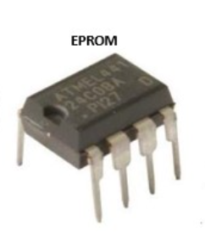
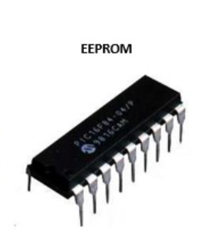
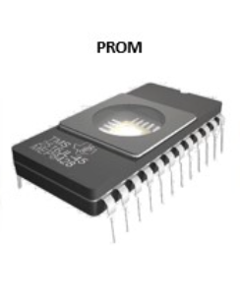
TYPes of ROm
ERASABLE PROGRAMMABLE ROM
PROGRAMMABLE ROM
ELECTRICALLY ERASABLE PROGRAMMABLE ROM

Slide 7
Key Differences Between RAM and ROM
Feature | RAM | ROM
Volatility | Volatile (loses data when powered off) | Non-volatile (retains data when powered off)
Read/Write | Can be read from and written to | Primarily read-only
Speed | Faster | Slower than RAM, but faster than hard drives
Capacity | Generally larger (measured in GB) | Typically smaller (measured in MB)
Usage | Temporary data storage for active processes | Permanent storage for essential instructions
Cost | More expensive per GB | Less expensive per GB
Accessibility | Directly accessible by CPU | Not directly accessible by CPU
Data Retention | Short-term | Long-term

Slide 8
Questions Q1 What is the second name of p Rom? Q2 rom is which type of memory? Q3 Why the data in rom is not lost after shutting down your system?
END OF PRESENTETION
Thanks

